Slide 1
Fast Hybrid Pipeline for Road and Non-Road Detection
WSN Project Presentation
Presenter
Sourish Chatterjee
EE22MTECH02002

Slide 2
Explain Problem Statement
The estimation of free road surface (henceforth: road detection) is a crucial component for enabling fully autonomous driving
Besides obstacle avoidance, road detection can also facilitate path planning and decision making, especially in those situations where lane markings are not visible (for example, because covered by snow or due to poor lightning conditions) or not present (for instance, in certain rural and urban roads).
Camera based approaches are strongly affected by environmental illumination. Therefore, their performance is expected to decrease considerably at night-time or whenever presented with light conditions that deviate from those seen during training.
LIDARs, on the other hand, carry out sensing by using their own emitted light and therefore they are not sensitive to environmental illumination.
Hence with lidar, same level of accuracy across the full spectrum of light conditions experienced in daily driving, and for this reason they are particularly suitable for achieving higher levels of driving automation.

Slide 3

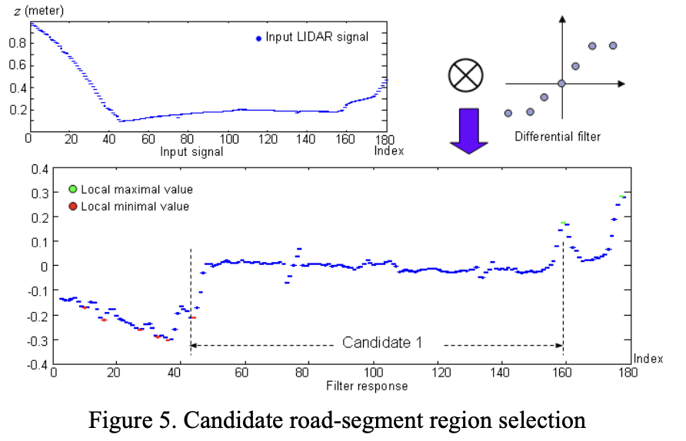
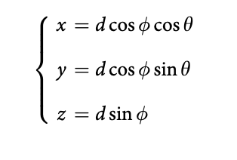
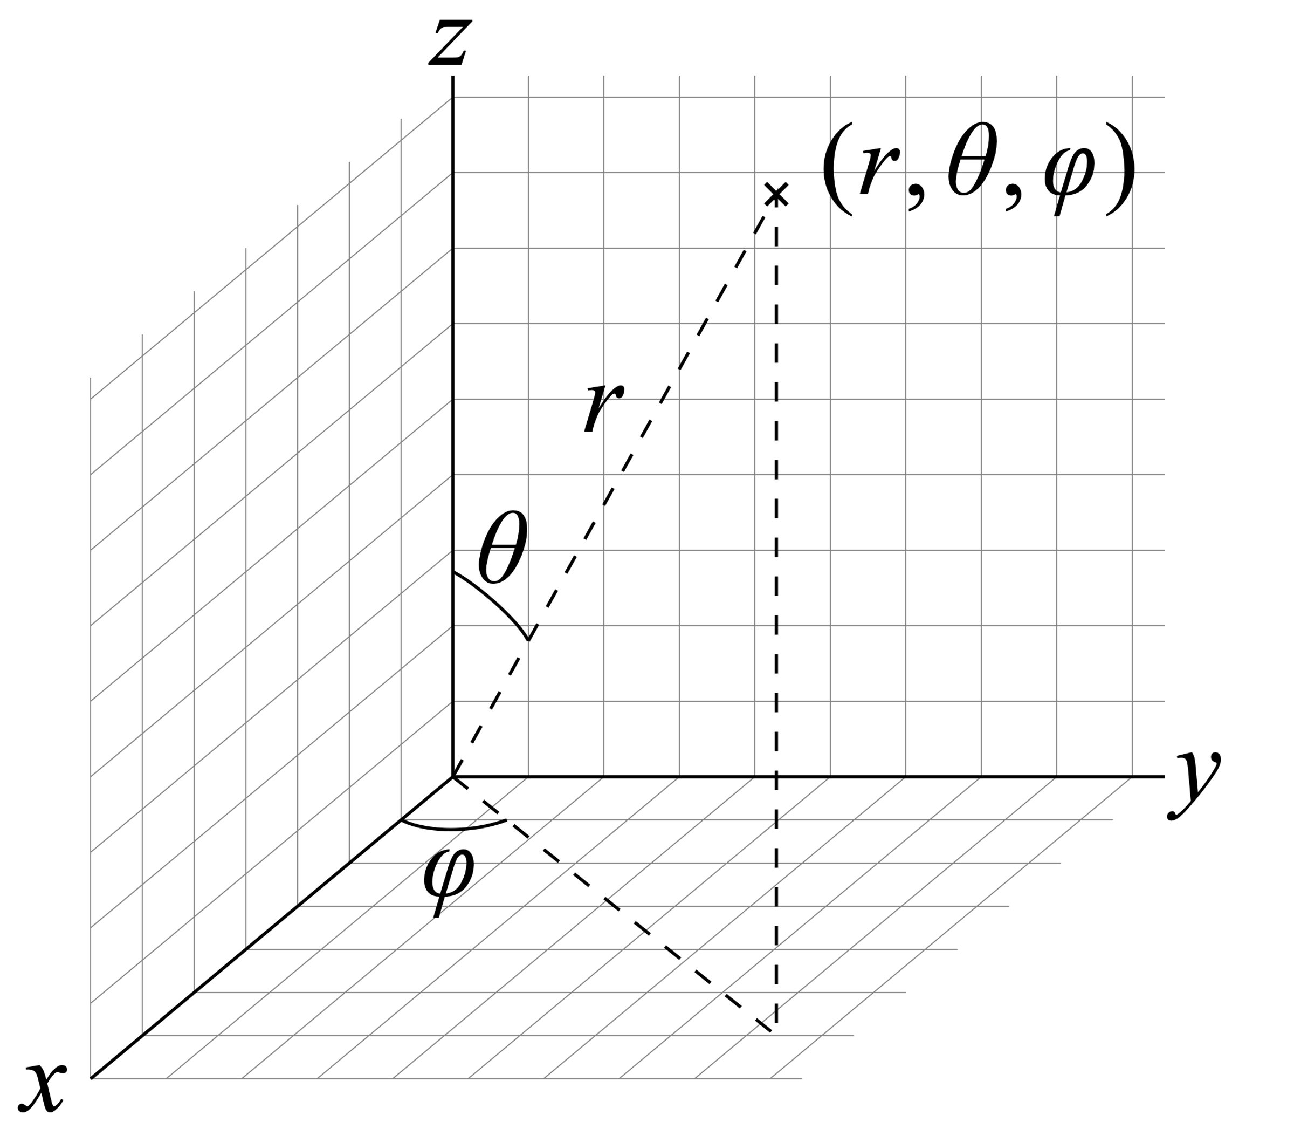
Understanding LIDAR Data

Slide 4
Literature Review
S No. | Literature review | Comments | Date
1 | LIDAR-based road and road-edge detection |  | 21-24 June 2010
2 | A real-time road detection method based on reorganized lidar data |  | April 16, 2019
3 | Fast LIDAR-based road detection using fully convolutional neural networks |  | 14 June 2017
5 | Progressive LiDAR adaptation for road detection |  | 06 May 2019

Slide 5
1.1 LIDAR-based road and road-edge detection
A road and road edge detection is done using a systematics processing of the elevation data extracted from the LIDAR. Steps are as follows
1. Identification of local maxima and minima using a Gaussian differential filter
2. Feature used for classification of the road is Weighted standard deviation
3. Classification is done using the extracted feature and putting a threshold on the parametrized form so that the Number of points also act as parameter
4. False alarm mitigation is done using average minimum road width
5. Curb detection using Hough Transform

Slide 6
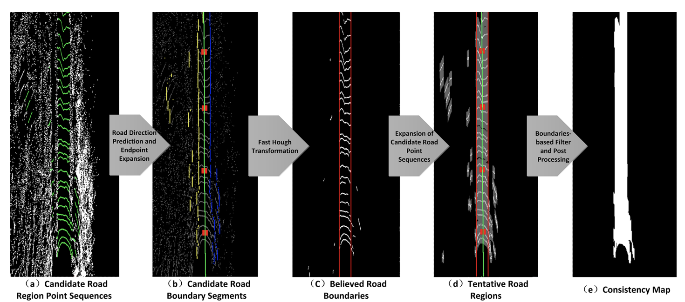
1.2 A real-time road detection method based on reorganized lidar data

Slide 7
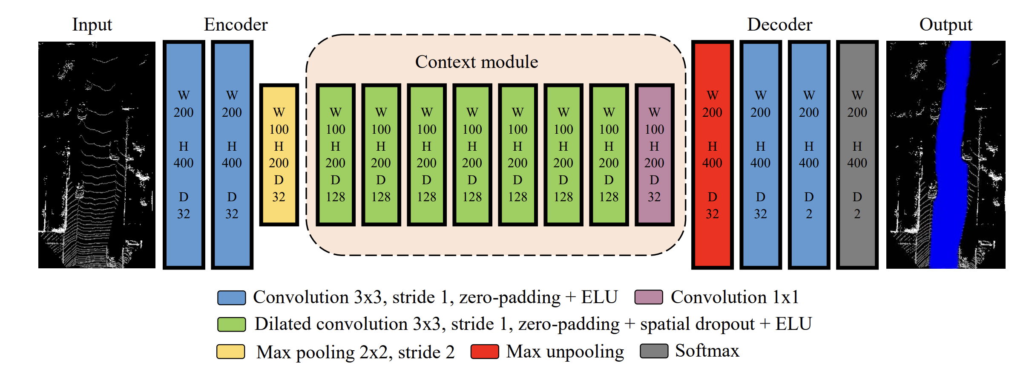
1.3 Fast LIDAR-based road detection using fully convolutional neural networks
the problem of road detection is framed as a pixel-wise semantic segmentation task in point cloud top-view images using an FCN.
road segmentation in real time, on GPU-accelerated hardware,
A top-view representation is, in our opinion, more appropriate than a camera perspective representation given that both path planning and vehicle control are executed in this 2D world

Slide 8
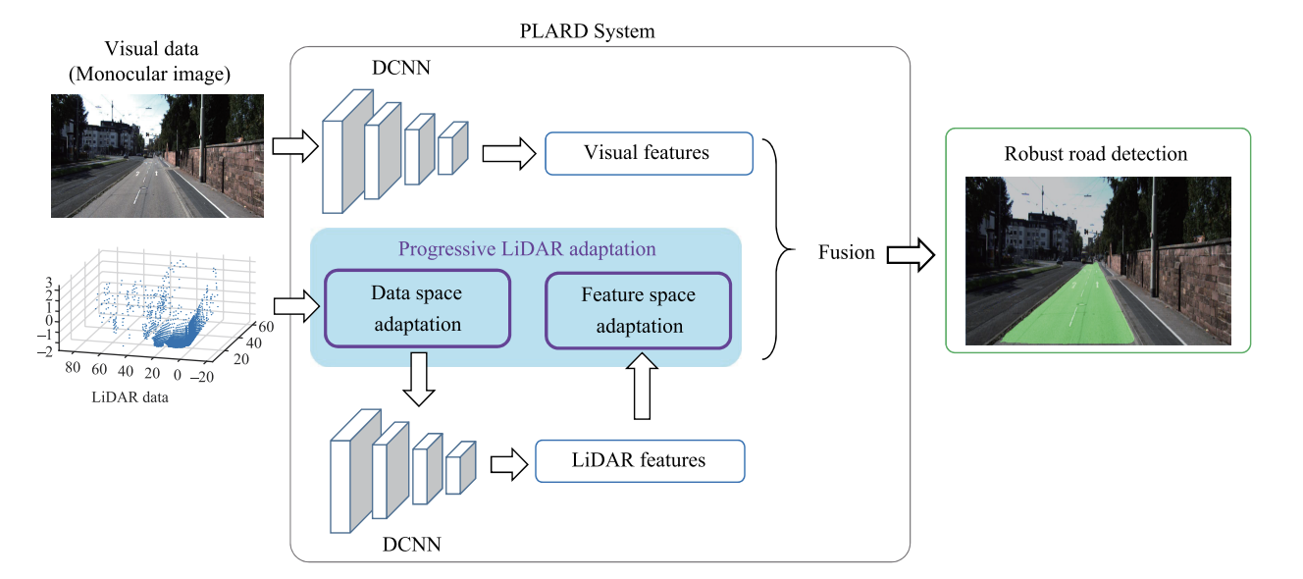
1.4 Progressive LiDAR adaptation for road detection
Data space adaptation, which transforms the LiDAR data to the visual data space to align with the perspective view by applying altitude difference-based transformation.
Feature space adaptation, which adapts LiDAR features to visual features through a cascaded fusion structure

Slide 9
2.1 System Diagram
Camera Data
Proposed Framework
Pixel Wise Segmented Camera Data, Augmented with LIDAR extracted Features
Data Adaptation
LIDAR Data

Slide 10
2.2 Motivating Architecture
Pipeline for Camera + LIDAR Data
DCNN
Visual Features
Fusion
Data Adaptation
DCNN
Feature Adaptation
Pipeline for LIDAR Data
Candidate Road Selection
Feature Extraction
Hough Transform
Marking of Road
Post Processing

Slide 11
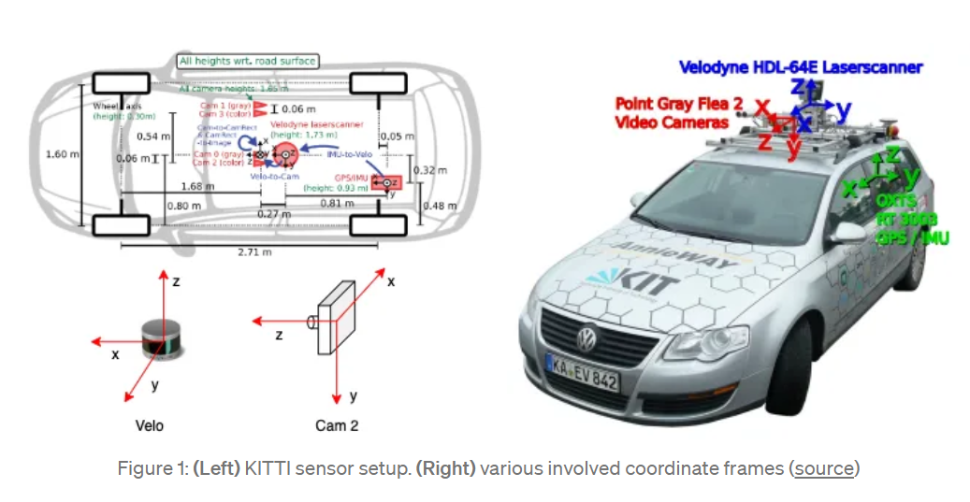
3.0 Dataset Description

Slide 12
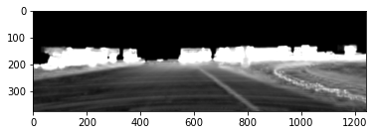
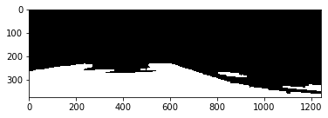
4.1 Implemented Framework
Please find the Code Repo here →
https://github.com/Sourish0911/Road_Detection_Project
Data Adaptation
Binary Image Processing Algo
ADI Image
Lidar Data Sub Sampling
Extract Z Coordinate
Apply Differential Filter
Extract Feature of std from output
Identify Road in the scan
Road Segmented Output

Slide 13
4.1.1 Computation of Altitude Difference Image(ADI)
Calibration Data
Point Cloud to Image Mapping
Maps the Points according to Image Height and Width to Image Plane
Create Temporary Mask based on Interpolation
Image Data
Compute the ADI in 3x3 windows
LIDAR Data
Normalize ADI Output

Slide 14
4.1.2 Flow for Binary Image Processing Algo
Take the Input Binary IMAGE(ADI)
Apply Mean Thresholding to Obtain Binary Image
Apply Erode Operation to Remove small White Blobs(Kernel Size 9x9)
Since the Range of Camera is Fixed Create Black Pixels for pixel number less than 200
Process the Image to remove the minor Blobs with parametrized size
Compared the processed output with PLARD Output

Slide 15
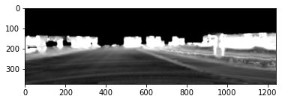
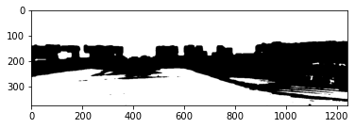
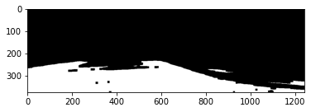
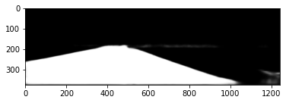
4.1.3 Visualization from Binary Image Processing Algo
1
2
4
3

Slide 16
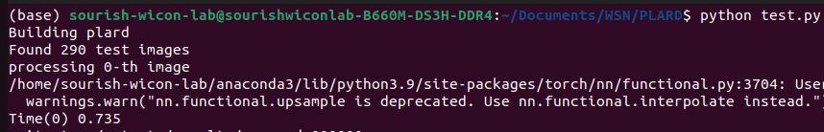
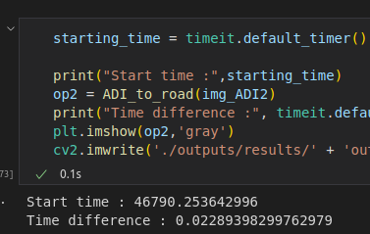
4.1.4 Trade-offs to be considered
Runtime as per PLARD Model
# The timing and accuracy of the model can be considered as an element of tradeoff between PLARD and Binary Image Processing Algorithm
# Also please note that currently BIP Algo is implemented in Python, once we implement this in c++ we would see faster performing model
Runtime as per Developed BIP Algo

Slide 17
4.1.5 Ideas to be considered for future
Use of motion-based mask to find Hough Transform
Use adaptive kernel size, thresholding for processing
Metric for Performance Indication

Slide 18
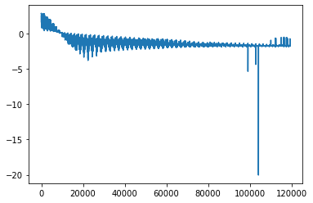
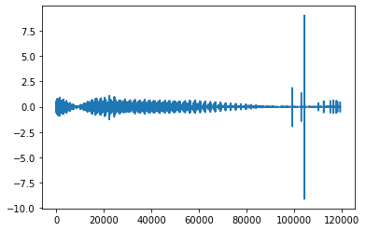
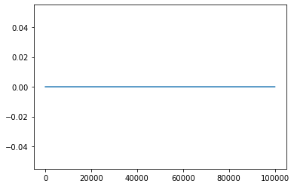
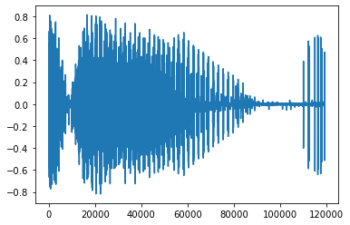
4.2.1 Visualization for Algo for LIDAR based road detection
Differential Filtering
Obtain feature – Weighted average and Std
Obtain indexes for rising maxima and falling minima
Apply thresholding

Slide 19
References
W. Zhang, "LIDAR-based road and road-edge detection," 2010 IEEE Intelligent Vehicles Symposium, La Jolla, CA, USA, 2010, pp. 845-848, doi: 10.1109/IVS.2010.5548134.
Xu F, Chen L, Lou J, Ren M (2019) A real-time road detection method based on reorganized lidar data. PLOS ONE 14(4): e0215159. https://doi.org/10.1371/journal.pone.0215159
Progressive LiDAR Adaptation for Road Detection, Zhe Chen, Jing Zhang, Dacheng Tao
L. Caltagirone, S. Scheidegger, L. Svensson and M. Wahde, "Fast LIDAR-based road detection using fully convolutional neural networks," 2017 IEEE Intelligent Vehicles Symposium (IV), Los Angeles, CA, USA, 2017, pp. 1019-1024, doi: 10.1109/IVS.2017.7995848.
. Fritsch J, Kuehnl T, Geiger A. A New Performance Measure and Evaluation Benchmark for Road Detection Algorithms. In: International Conference on Intelligent Transportation Systems (ITSC); 2013.

